Slide 1



Product & Order Management
(E-Commerce Domain)
02 April 2026
Macro Project
Trainer : Arun Kumar G.
Notes:
‹#›

Slide 2


Problem Statement
The Problem
E-commerce operations are scattered — products, orders, inventory, and logs are not managed in one unified system.
Impact
Wrong stock levels
Delayed/failed order updates
Confusing order tracking
No audit trail
Need
A centralized system to manage products, orders, inventory, and activity logs securely.

Slide 3
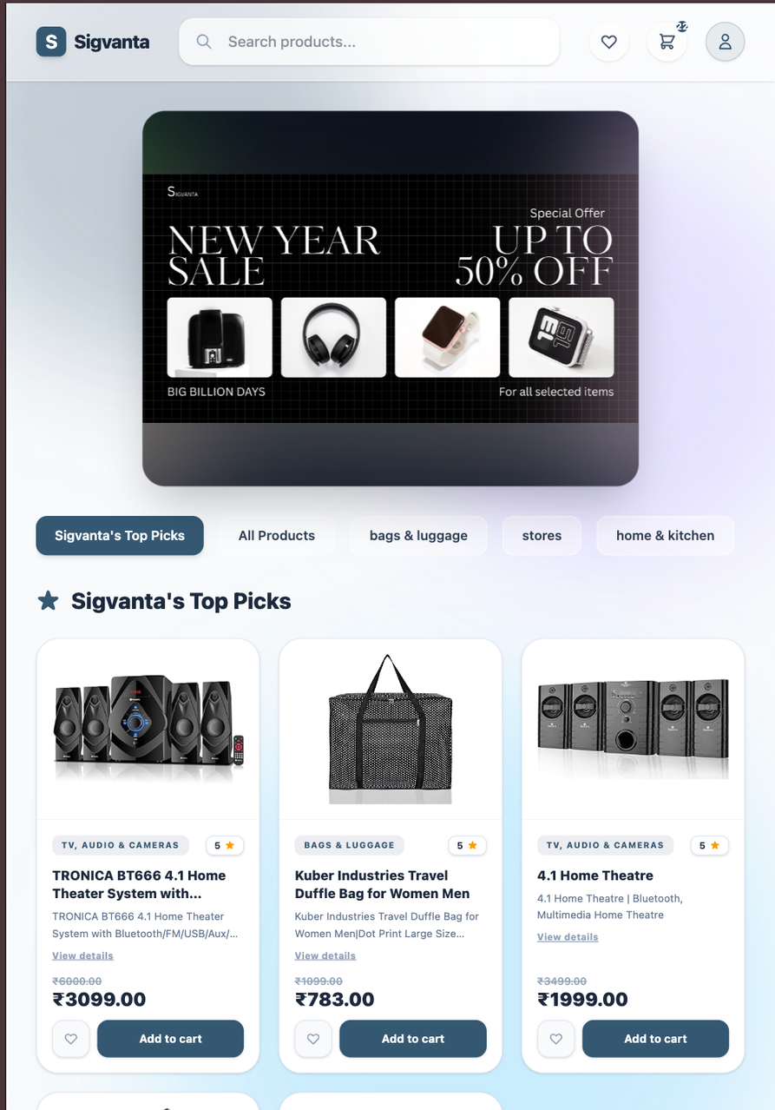
Our Solution
Unified Management Platform
A single system that manages products, categories, orders, inventory, and logs in one place tested on a real sales dataset of amazon 2023
Automated Order & Inventory Flow
Real-time stock deduction on order
Order lifecycle tracking (Pending → Placed → Shipped → Delivered → Cancelled)
Secure Access
Google OAuth login
JWT-protected APIs
Role-based access (Admin / Customer)
Complete Activity Logging
All actions (orders, product updates, auth events) stored in MongoDB logs for monitoring & audits.

Slide 4
Members and their responsibilities
Name | Task
Mohammad Rustam | Designed and developed the complete Inventory Management system (frontend + backend) with dashboard architecture and initial UI/UX design.Handled frontend routing, structured scalable project architecture, and integrated all modules end-to-end.
Nikhil CS | Engineered core shopping interfaces (Homepage, Catalog, Wishlist) powered by a custom weighted search engine with dynamic pagination, and real-time discount sorting while utilizing a processed Amazon sales dataset for real-world product catalog.
Om Jadhav | Built REST APIs for order management with full lifecycle tracking and admin controls. Developed customer order history and admin orders page with search, filters, sorting and pagination.
Madhur Suresh Rao | Developed the Cart interface end-to-end, handling backend logic, API integration, and frontend UI, ensuring seamless interaction with wishlist, and order modules.
Kalpana Meena | Implemented admin Category Management system, where CRUD operations are handled through backend APIs, along with search using debouncing, sorting, and pagination to ensure efficient data handling and performance.
Mohammed Faizan | Engineered a scalable audit and activity logging system capturing authentication, admin actions, and order lifecycle events. Implemented non-blocking logging, structured MongoDB collections, and integrated log monitoring via admin dashboard.
Nikhil Kumar Gupta | Worked on the backend development, handling all routes, authentication, and middleware implementation related to USER. I builtAPIs with JWT, OTP verification, and role-based access. I also managed user operations and overall request flow.
Pankaj Kumar Rai | Developed frontend for Login, User Profile, and Admin Profile with role-based functionality. Implemented CRUD operations for user management including profile update, account deletion, and data retrieval.

Slide 5
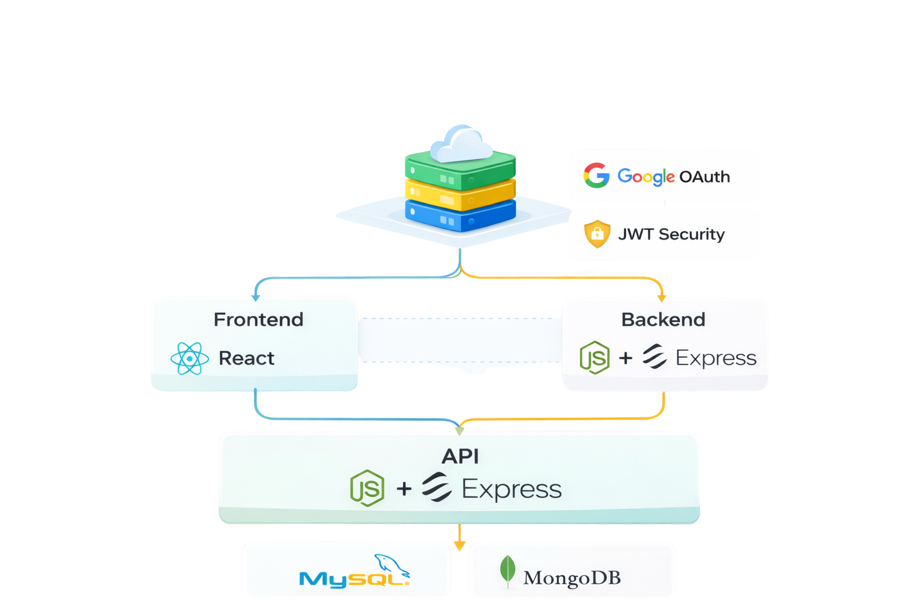
Tech Stack

Slide 6
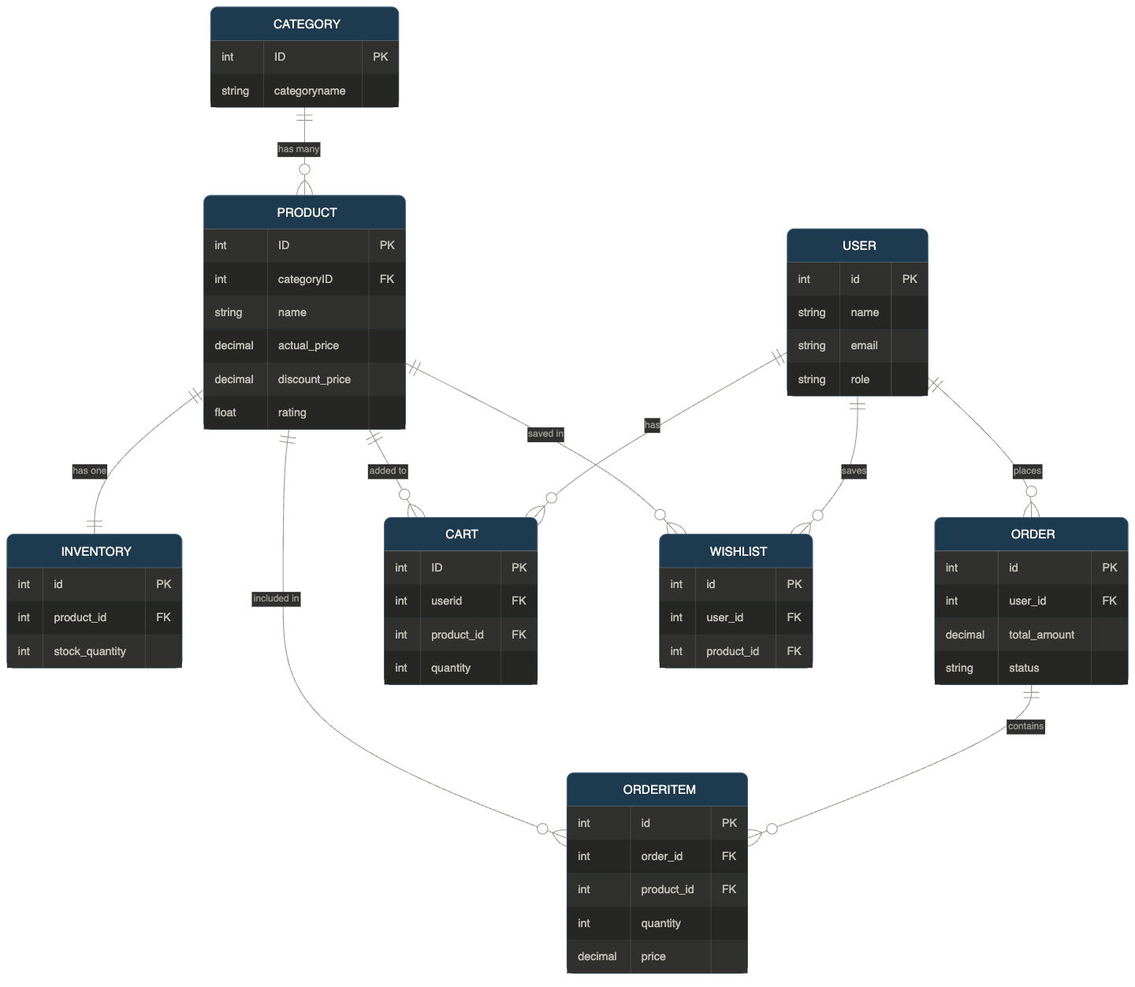
Tables &
Relationships

Slide 7
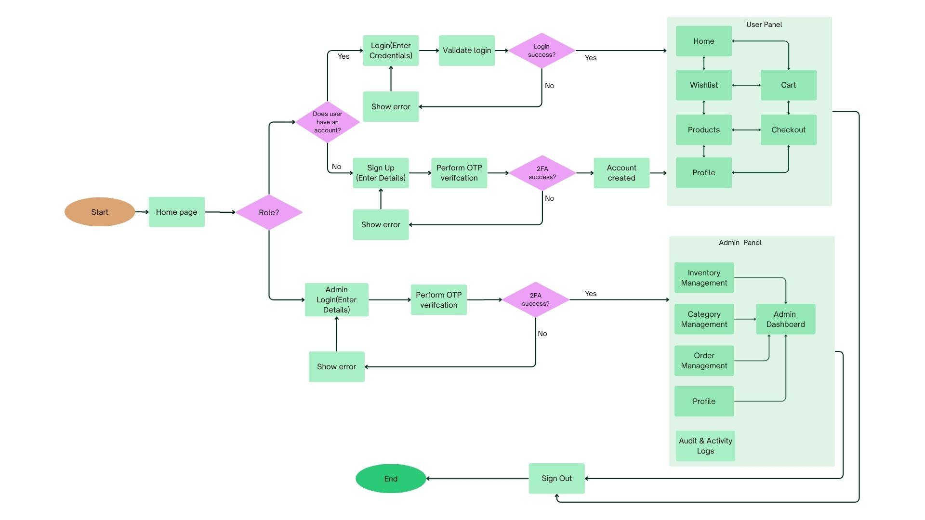
Project Flowchart
‹#›
Notes:
‹#›

Slide 8
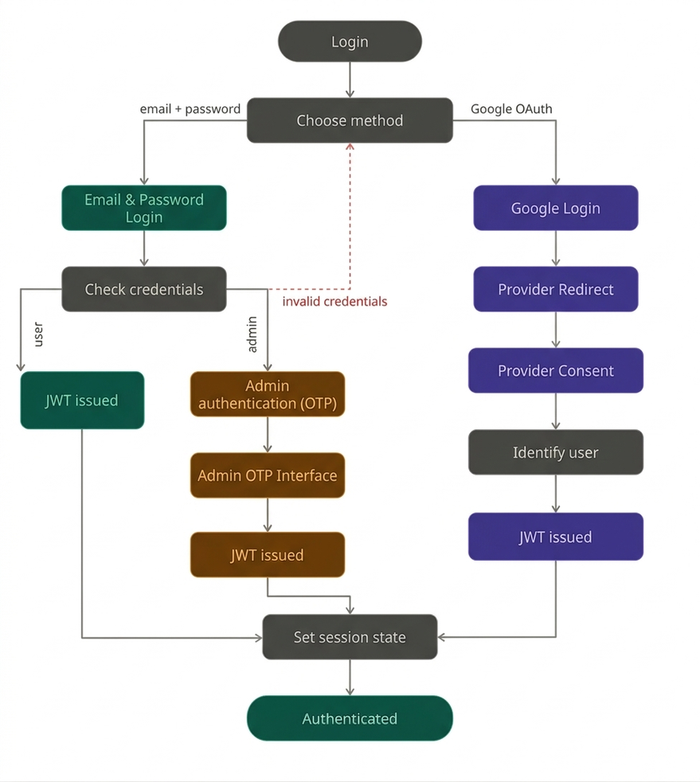
User Management and Authentication
Login Frontend Features
Role-based login system (User / Admin toggle)
Secure password validation with show/hide functionality
Controlled form handling with real-time validation and error feedback
Navigation using React Router for seamless page transitions
Session management using LocalStorage
Modular and reusable components (CustomInput, ToggleSwitch)
Clean, responsive UI with smooth user interaction

Slide 9
User Management and Authentication
UserController
Manages user profile operations
Update profile (name, email, avatar)
Delete account functionality
Fetch user details (single & multiple users)
Auth Routes
Handles authentication & security
Login & Signup functionality
OTP verification (User & Admin)
Password reset & forgot password
Google OAuth integration
Admin Request System
Users can request admin access with reason
Admin can view all requests
Admin can Accept / Reject requests
Role updated after approval

Slide 10
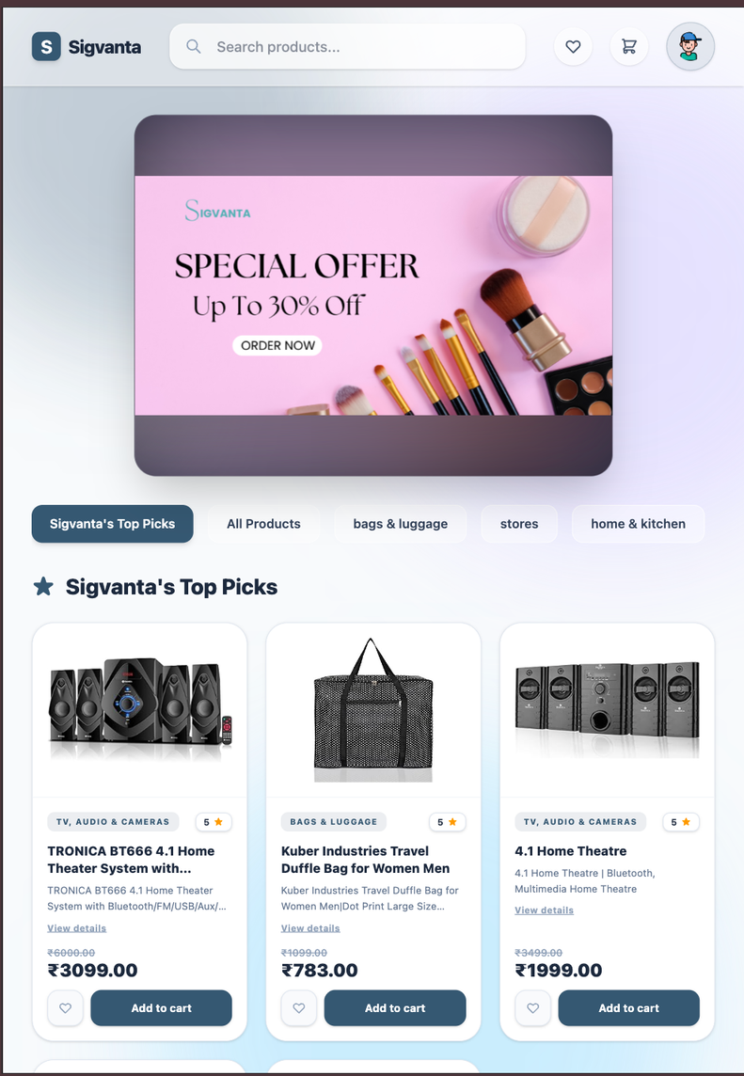
Home Page
🔹 Purpose
Serves as the central landing hub and primary discovery engine for the application, allowing users to browse curated categories, view top picks, and search the entire catalog.
🔹 Key Features
Advanced Weighted Search
Seamless right-to-left animated banner carousel
Curated Content
Interactive Category Bar
Role-Aware Header
🔹 Integrations
Cart Module→ Add items into user’s cart
Wishlist Module → tap a heart icon to wishlist a product

Slide 11
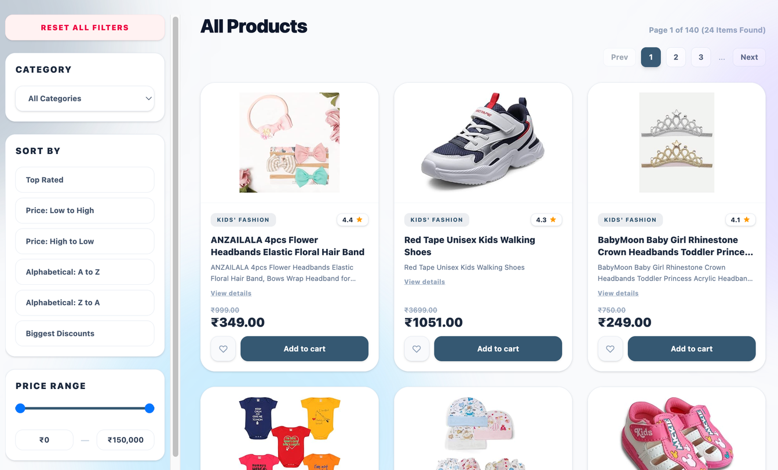
Product Catalog(category specific and non specific)
🔹 Purpose
Serves as the comprehensive catalog browsing experience and empower users to explore inventory using shared, advanced controls for filtering, sorting, and pagination
🔹 Key Features
Universal Weighted Search:
Dynamic Pagination:
Advanced and intuitive Sorting
🔹 Integrations
Cart Module→ Add items into user’s cart
Wishlist Module → tap a heart icon to wishlist a product

Slide 12
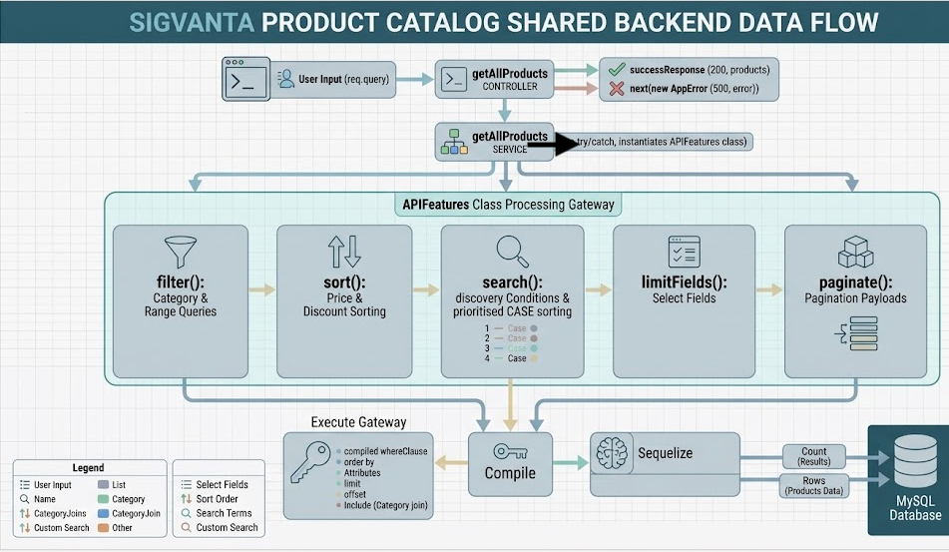
Shared Backend Data Flow

Slide 13
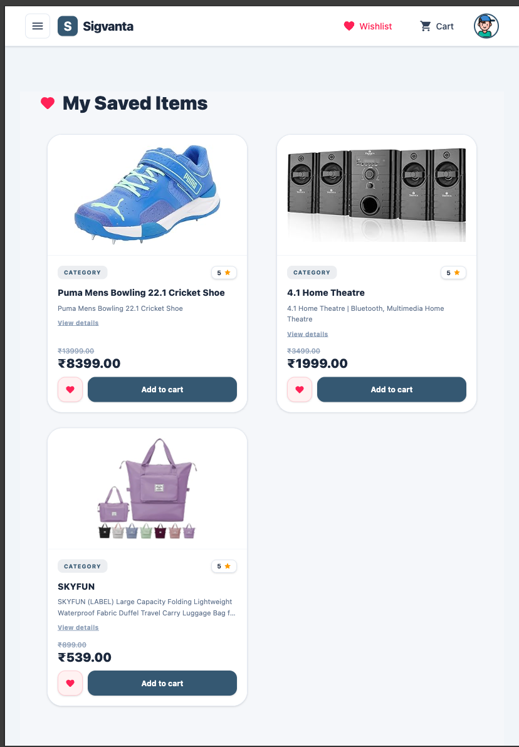
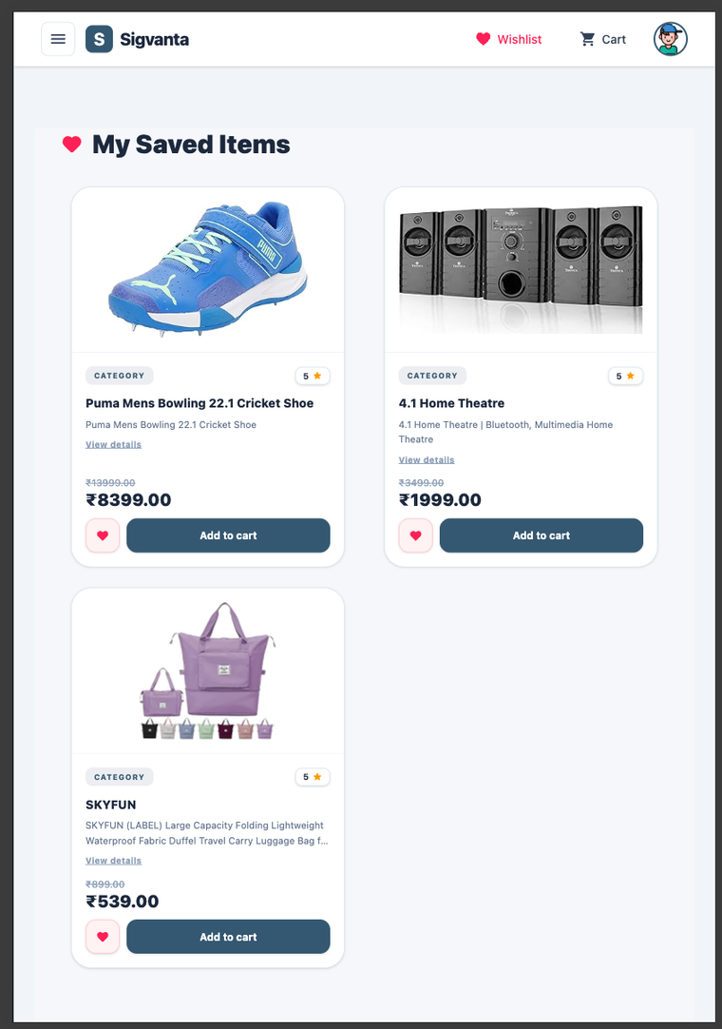
Wishlist Page
🔹 Purpose
Saves and manages items selected by users for future consideration,
acting as a bridge between Products and the Cart
🔹 Key Features
Add items directly from Homepage and Product pages
View a persistent list of saved items for later consideration
Move individual items to Cart with a single click
Remove individual items from the list
Real-time UI updates upon item addition or removal
🔹 Flow
🔹 Inbound Flows:
Homepage ➔ Product Card ➔ Add to Wishlist
Homepage ➔ All Products Page ➔ Product Card ➔Add to Wishlist
🔹 Outbound Flows:
Wishlist Page ➔ Select Item ➔ Move to Cart ➔ Cart Page

Slide 14
Category Management
🔹 Key Features:
CRUD operations via REST APIs (Node.js, Express, Sequelize, MySQL)
Search with debouncing, sorting, and pagination for performance
Validation & error handling using Joi and centralized middleware
React Category Page (Admin UI)
↓
Category Service (Axios – getAll, create, update, delete)
↓
Express Category Routes (/api/v1/category)
↓
Category Controller (handles request & response)
↓
Category Service Layer (business logic + validations)
↓
Sequelize Category Model
↓
MySQL (categories table)
🔹 Frontend:
Built with React (useState, useEffect, useMemo)
Modular components (Table, Filters, Modal)
Axios service layer for API integration
🔹 Optimization & UX:
Optimized rendering using useMemo
Added loading states, toast notifications, and empty states

Slide 15
Inventory Management
React Inventory Page
Admin UI — InventoryFilters, InventoryTable, InventoryModal
Key Features:
Full CRUD via REST APIs (Node.js, Express, Sequelize, MySQL)
Search, filters, sorting & server-side pagination
Real-time stock quantity with Low / Medium / High badges
Image upload via Multer + Cloudinary (returns secure URL)
inventoryService.js
Axios — getProducts, createProduct, updateProduct, deleteProduct, uploadImage
Express Inventory Routes
/api/v1/inventory • /api/v1/inventory/uploadImage
Frontend:
React with useState, useEffect, useCallback, useRef
Split into InventoryFilters, InventoryTable, InventoryModal
Axios service layer for all API calls (inventoryService.js)
Instant image preview before upload using createObjectURL
Optimization & UX:
Debounced search (400ms), Apply Filters button for rest
Skeleton loaders, empty states & inline error banners
Inventory Controller
Handles request & response, calls service layer
Multer + Cloudinary
Parses file buffer → streams to Cloudinary → returns secure_url
Sequelize Product + Inventory Models
Products & Inventory tables — AdminAPIFeatures for filtering
MySQL Database
products table • inventory table

Slide 16
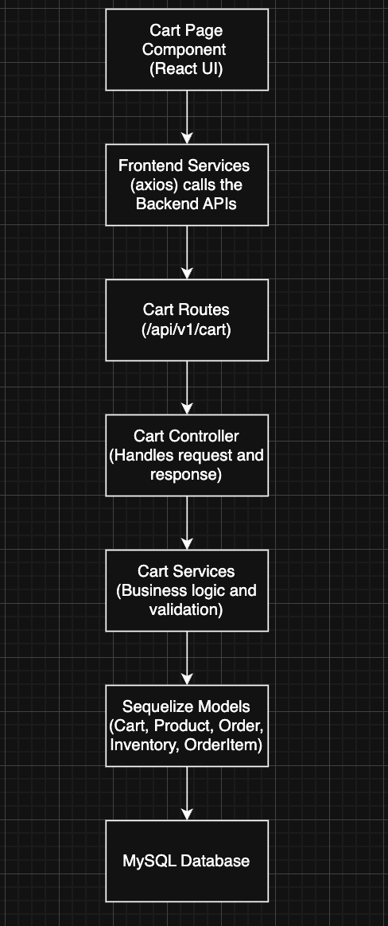
Cart Interface
🔹 Purpose
Manages items selected by users before purchase,
acting as a bridge between Products, Wishlist, and Orders.
🔹 Key Features
Add items from Products and Wishlist.
Update quantity (increase/decrease) with inventory validation.
Remove individual items or empty entire cart.
Real-time total price calculation.
Checkout flow with confirmation modal and order summary.
Redirection to Orders page
🔹 Integrations
Orders Module → Cart items are converted to customer-specific orders.
Wishlist Module → Move items to cart seamlessly.
🔹 Highlights
Personalized cart per user
Smooth UX with modals and real-time updates
Scalable and modular architecture

Slide 17
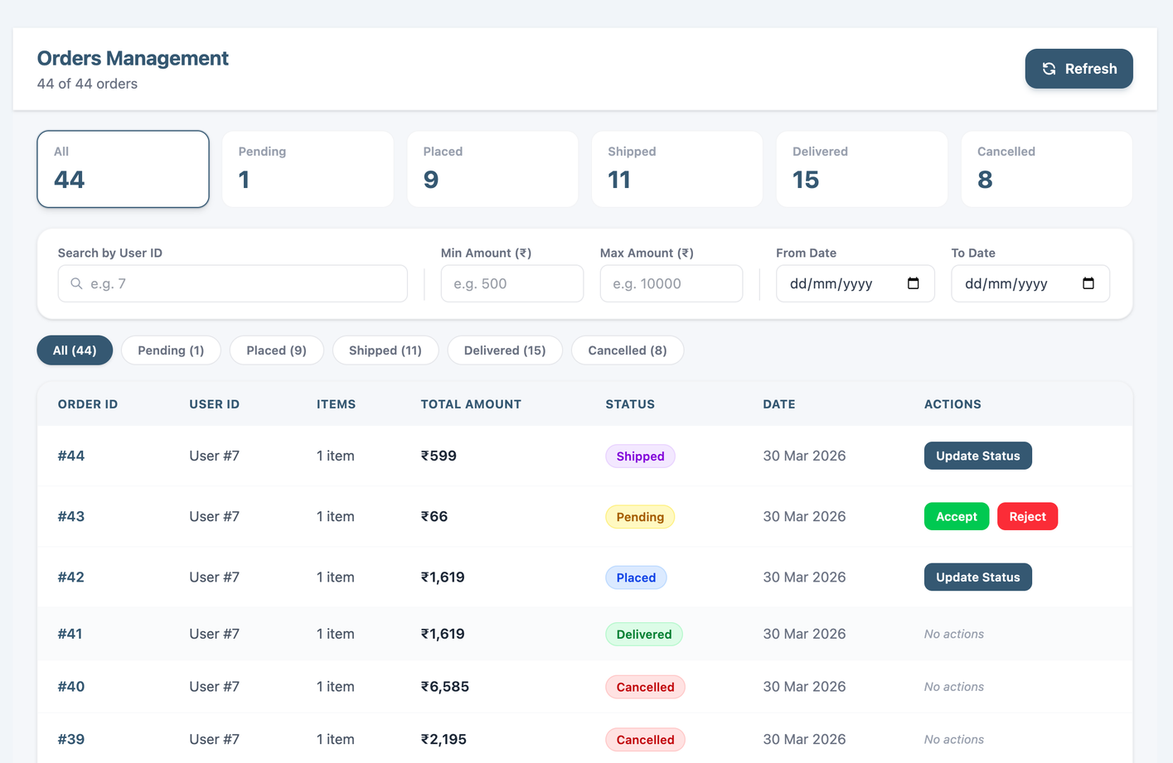
Orders Management
Admin panel to monitor, manage, and update all customer orders in real time.
Paginated table with Order ID, User ID,
items, total amount, status & date
Instantly accept or reject incoming
customer orders with a single click
Quickly locate orders by searching with the
customer's User ID
Update delivery status: Pending → Placed
→ Shipped → Delivered → Cancelled
Filter orders by: Pending, Placed, Shipped,
Delivered, Cancelled
Narrow results by minimum to maximum order amount and date range

Slide 18

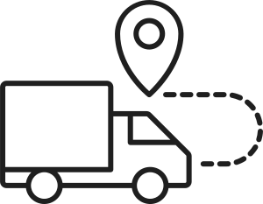


Order History Page
Customer-facing order history panel to view, track, and cancel pending orders in real time.
Filter orders by status-All, Pending, Placed, Shipped, Delivered, Cancelled
Order card shows Order ID, Date, Total Amount, Item Count & Status Badge
Visual order progress tracker — Step-by-Step Status Timeline:
Pending → Placed→Shipped →Delivered
Itemized order breakdown with Product Image, Name, Quantity & Price
Order Total displayed at the bottom of each card
Cancel order option available for Pending Orders

Slide 19
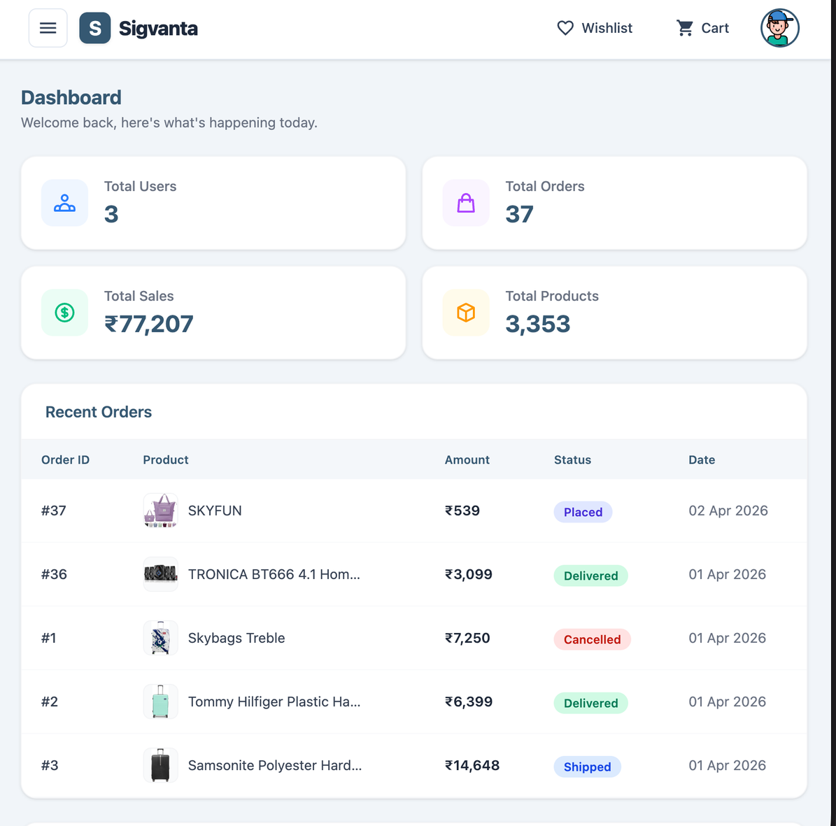
Admin Dashboard Page
Key Features:
Aggregated stats: Total Users, Total Orders, Total Sales, Total Products
Recent Orders table with product image, amount, status & date
Recently Added Products with price snapshot
New Users table with avatar, role badge & join date
Frontend:
React with useState, useEffect
Modular components: StatCard, RecentOrdersTable, RecentProductsTable, RecentUsersTable
Currency formatted in ₹ INR, dates in Indian locale
Status badges with color coding (pending, placed, shipped, delivered, cancelled)

Slide 20
Audit and Activity Logging
🔹 Objective
Ensure accountability, traceability, and security of admin actions
Enable debugging and system monitoring
🔹 How logs are generated
After successful inventory operations
Backend calls writeActivityLog(...)
Logging is best-effort (Non-Blocking)
🔹 Security & Access
🔐 JWT Authentication
👤 Role-Based Access (Admin only)

Slide 21
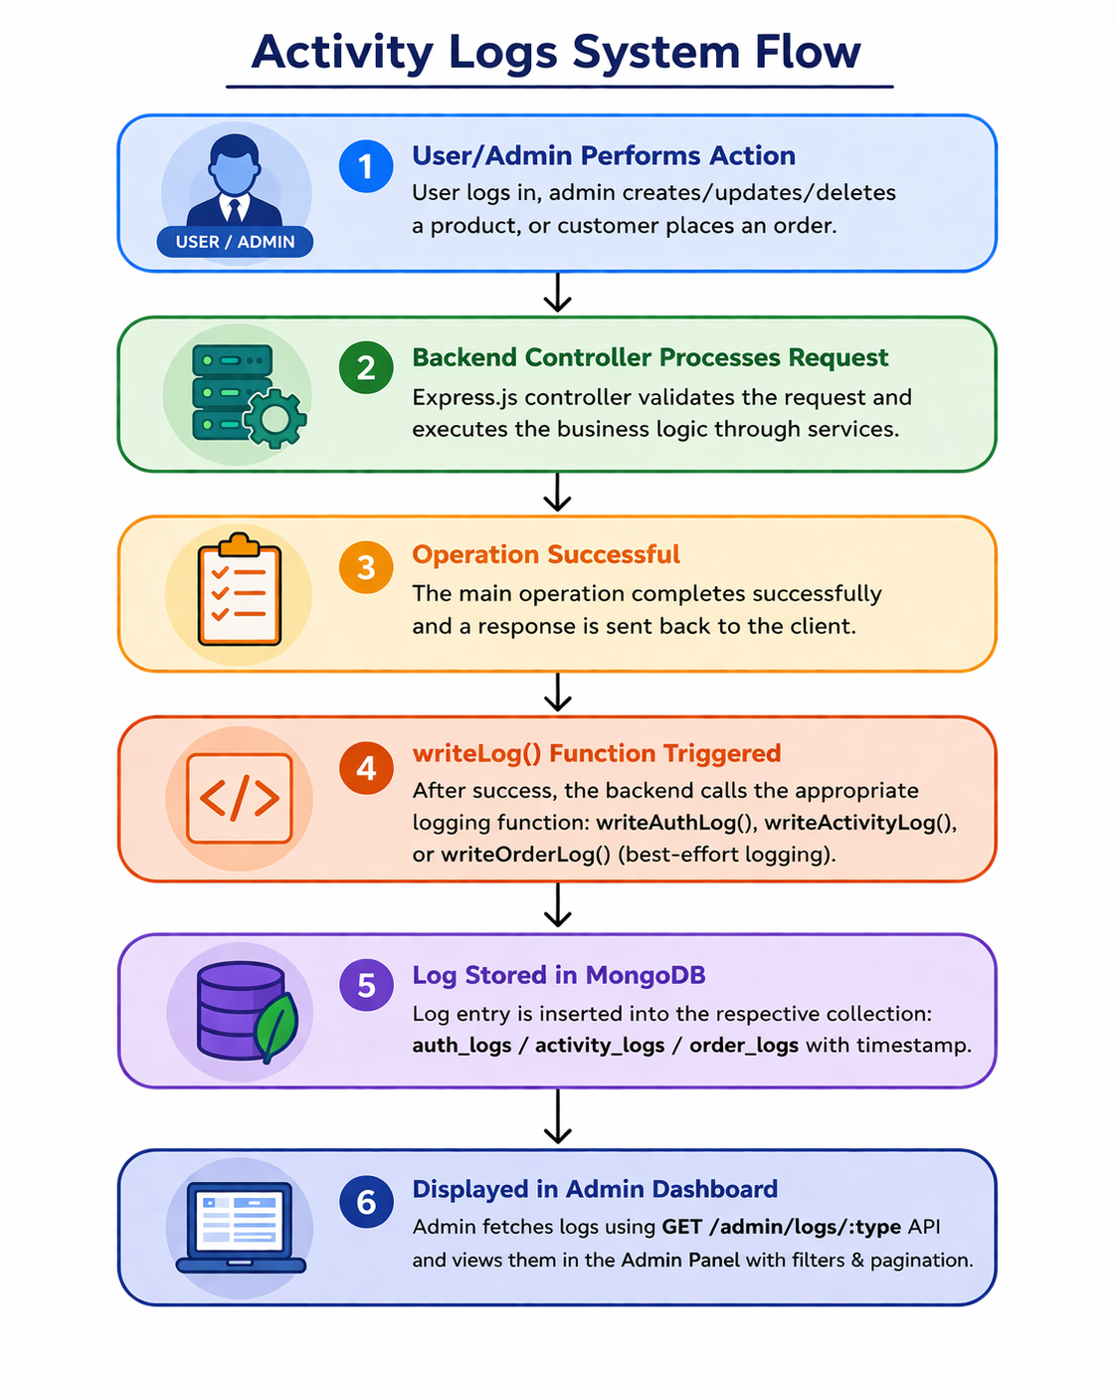

Slide 22

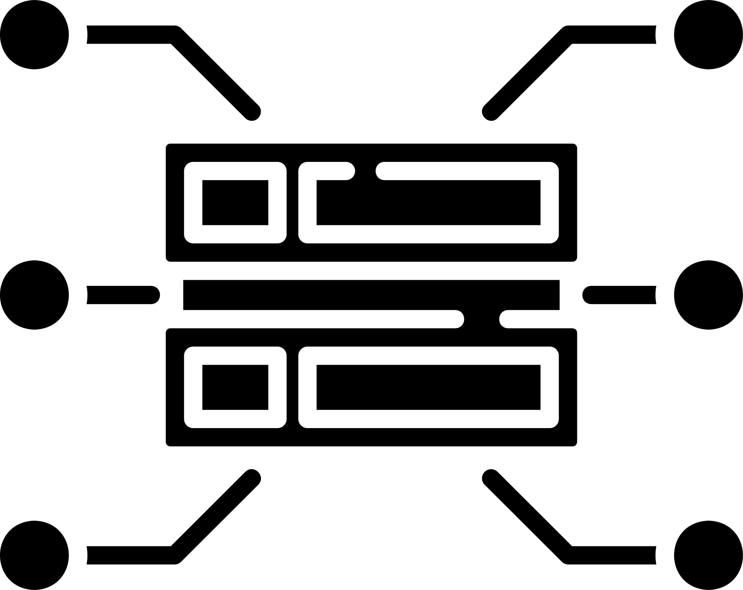



Performance Optimization
API & Database
Faster SQL queries
Reduced unnecessary DB calls
Optimized controller → service flow
Fetched only required fields (no heavy queries)
Pagination
Applied on products, categories and orders
Smaller API responses → quicker page load
Middleware
JWT middleware optimized for quick authentication
Network Optimization
Search debounce to limit rapid API calls
Rendering Optimization
Used React memoization (useMemo, useCallback)
Reduced unnecessary re-renders
Cleaner component structure → smoother UI

Slide 23

Additional Features Implemented
Amount range filtering
Responsive modal form
Error messaging
Form validation
Multiple sort options
Delete confirmation dialogs
Clean and modern UI
Role-based access control
Real-time totals
Loading spinners
Icons for better UX
Pagination

Slide 24






Future Scope
Integrate real-time order tracking with live location updates using maps APIs
Implement online payment gateways (Stripe/Razorpay) with secure transaction handling
Add recommendation system based on user behavior and purchase history
Enhance scalability using microservices architecture and containerization (Docker + Kubernetes)
Introduce real-time notifications (email/SMS/push) for order updates
Improve analytics with admin dashboards for sales insights and user activity

Slide 25
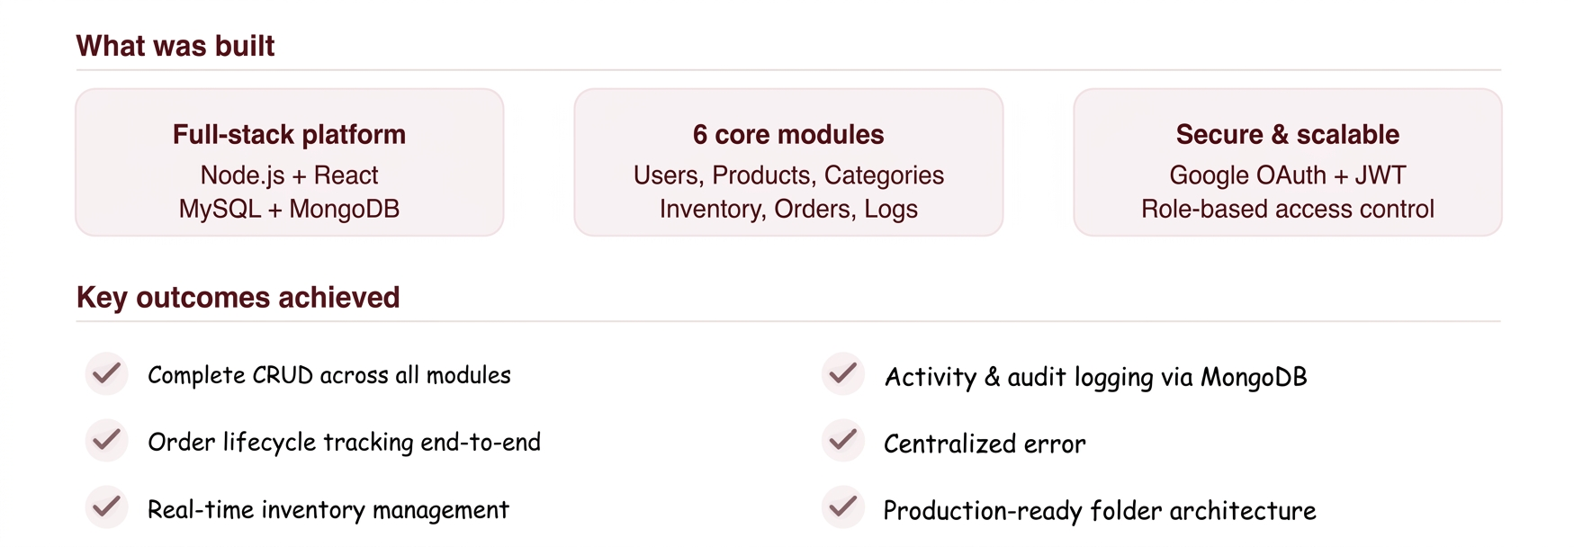
Conclusion
Built a scalable, secure, and production-ready e-commerce system

Slide 26
Thank You

